Slide 1

Analog Computer
EN2091 - Laboratory Practice and Projects.
Group 12 - Outlaws

Slide 2
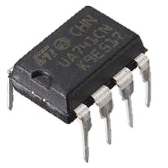
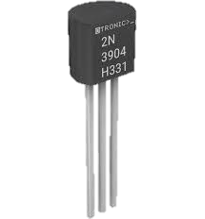
Analog Computer
EN2091 - Laboratory Practice and Projects.
Group 12 - Outlaws
LM741 Op-Amp:
Availability & Cost: Widely available and affordable.
Simplicity: Ideal for basic operations like addition, subtraction, and integration.
Frequency Response: Bandwidth (~1 MHz) is sufficient for 1 kHz to 10 kHz signals.
Ease of Use: Stable and easy to implement without complex compensation.
Component Selection
2N3904 Transistors:
High Availability & Low Cost: Commonly available, low-cost NPN transistors.
Frequency Response: Transition frequency of ~300 MHz easily handles 1 kHz to 10 kHz operations.
Versatility: Suitable for various analog applications, including the Gilbert cell multiplier.
Low Power Consumption: Minimizes heat dissipation, ideal for compact analog circuits.

Slide 3
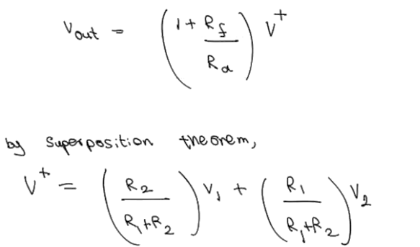
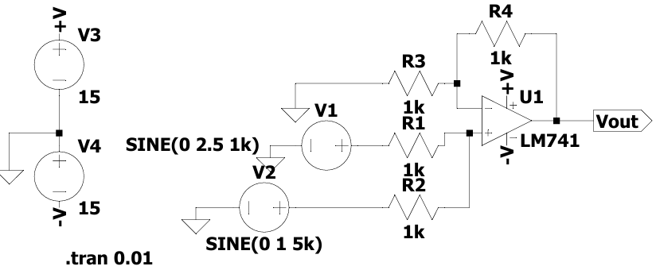
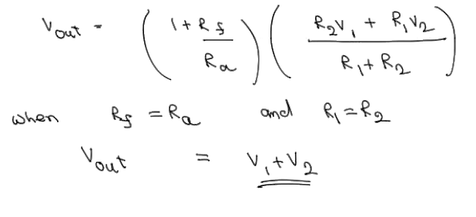
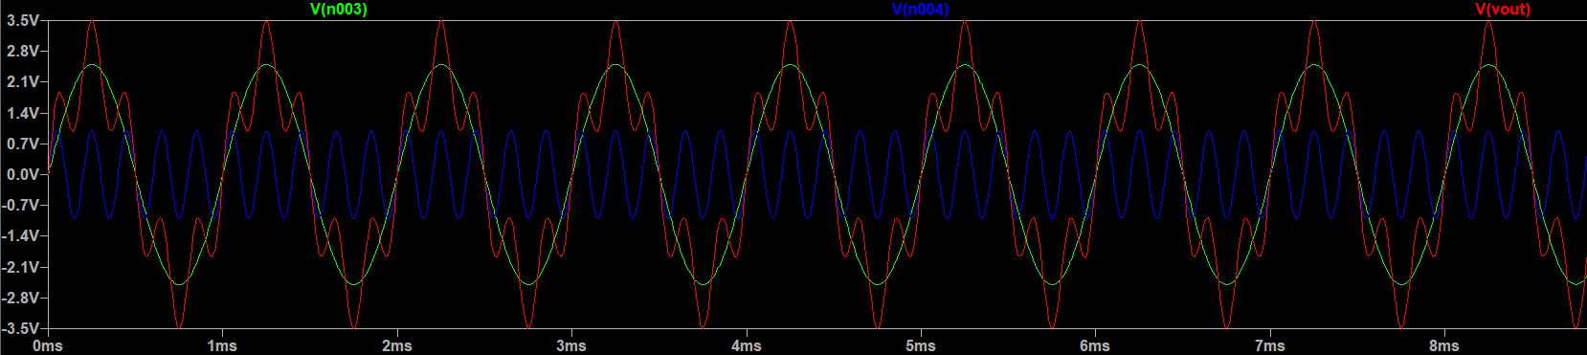
Simulation Results.
Adder Circuit.

Slide 4
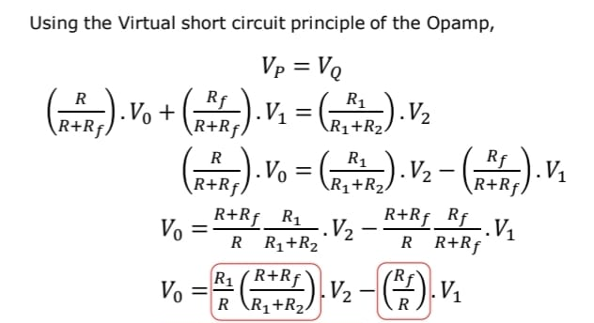
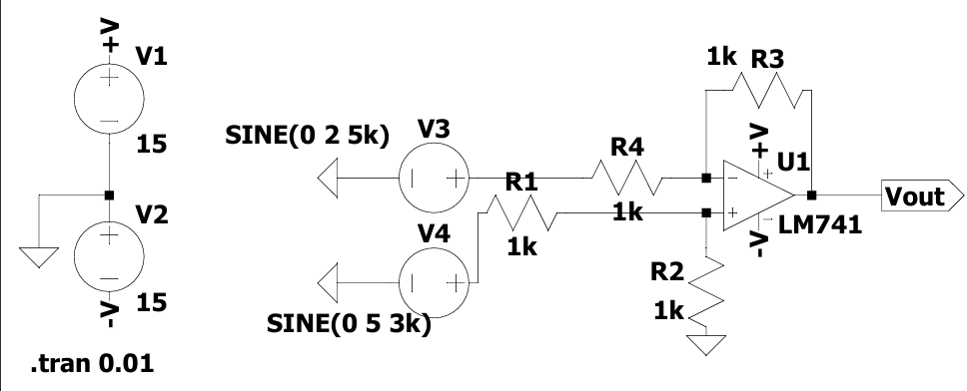
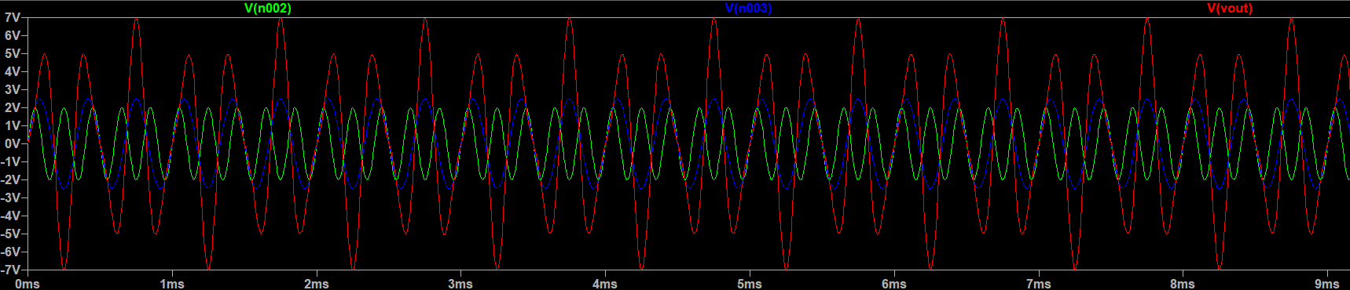
Simulation Results.
Subtractor Circuit.
V_{o} = K₂V₂ – K₁V₁
Choosing all the resistors as 1kohm, we get
Vo = V2 – V1

Slide 5
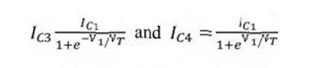
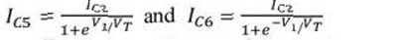
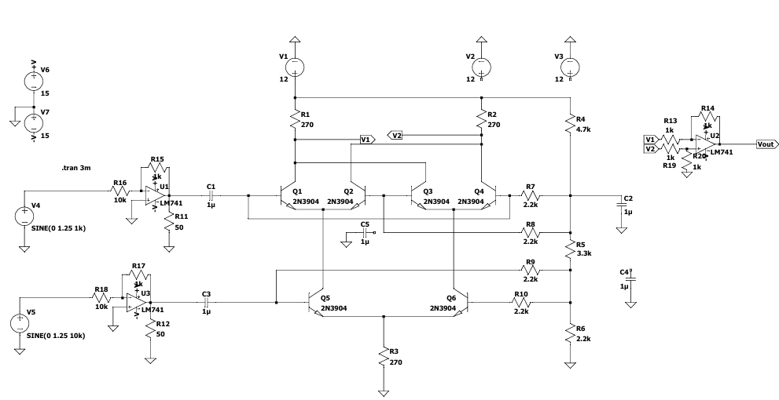
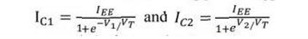
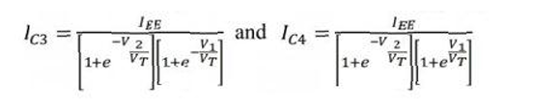
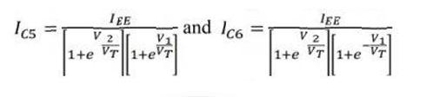
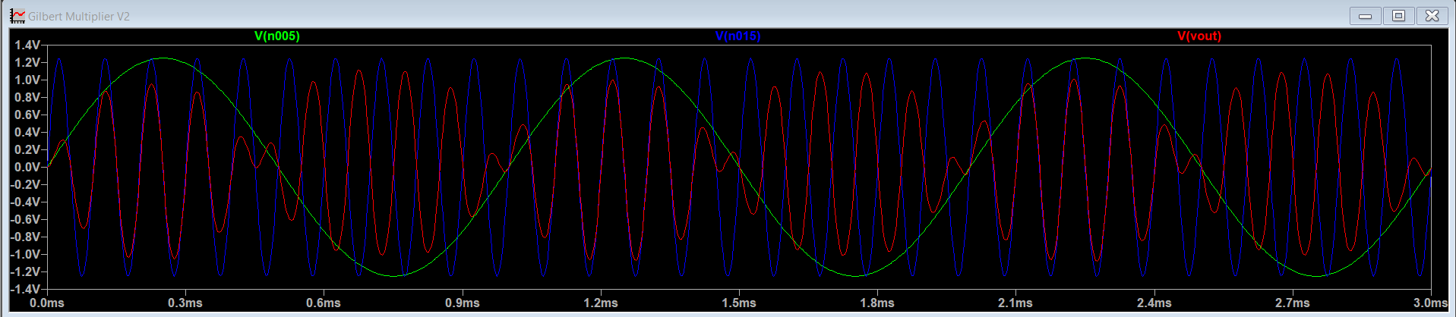
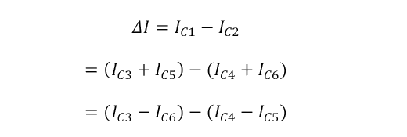
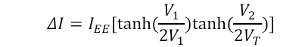
Simulation Results.
Multiplier Circuit.
The collector current of Q3 and Q4 are given by
The collector current of Q3 and Q4 are given by
The collector current IC1 and IC2 of transistors Q1 and Q2 can be expressed as
Substituting the above equation in IC3 and IC4, we get
Substituting the above equation in IC3 and IC4, we get
The differential output current I is given by
Substituting the above equations and it employ exponential formulae for hyperbolic functions, we get

Slide 6
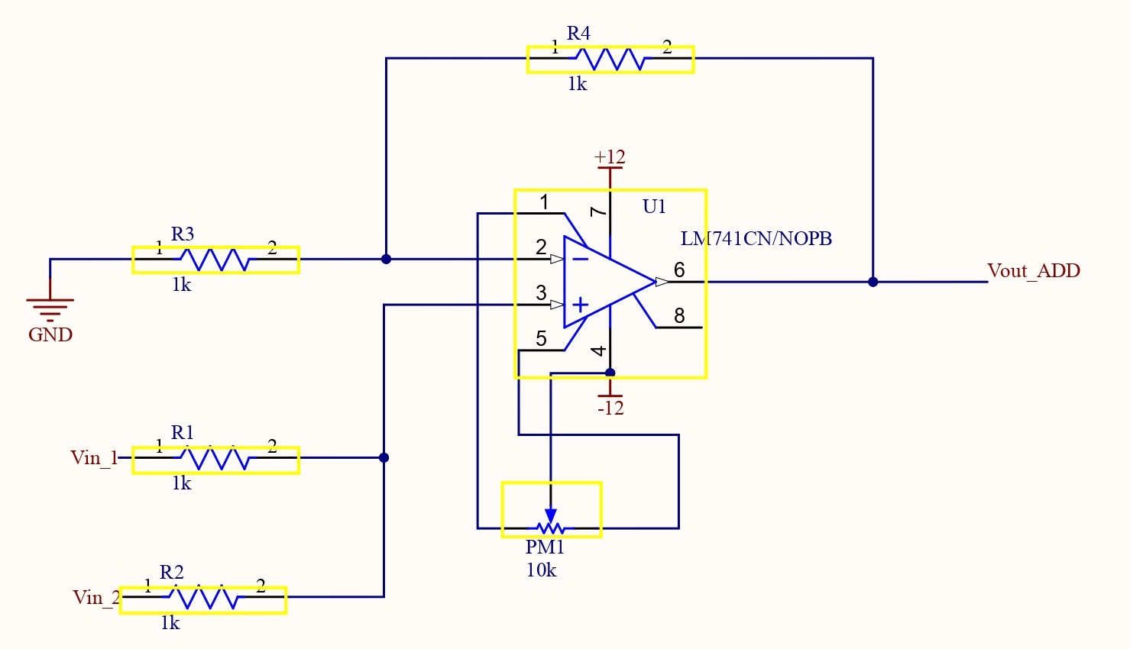
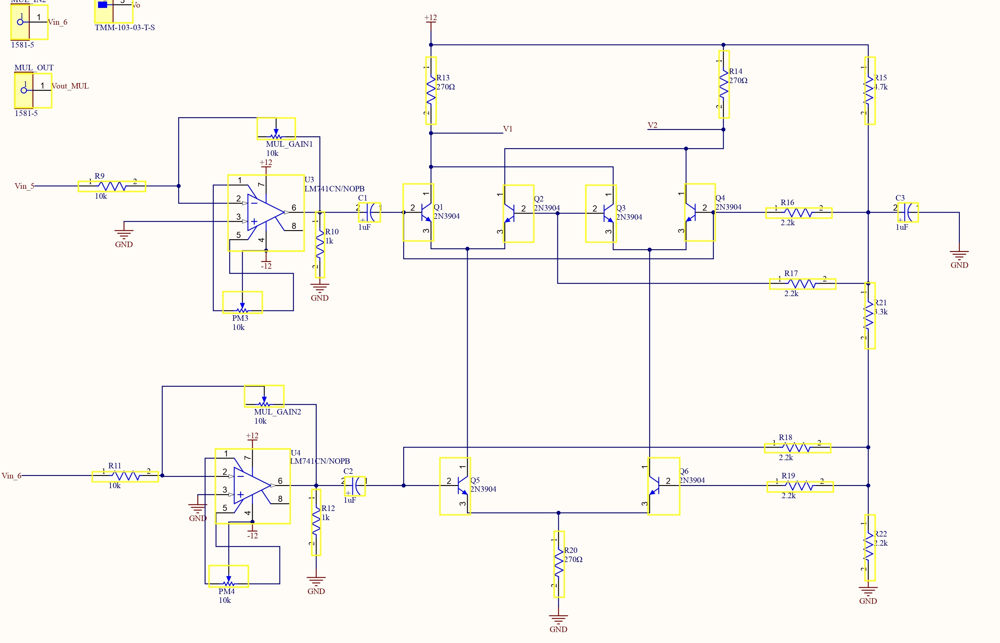
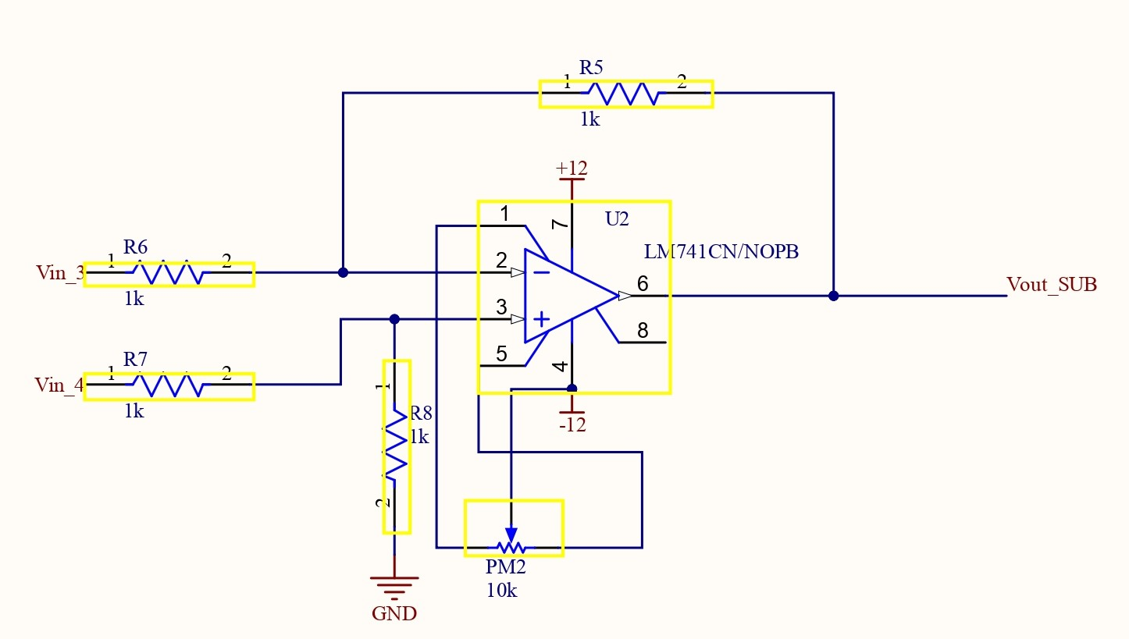
Schematic Diagrams.
Adder Circuit
Subtractor Circuit
Multiplier Circuit

Slide 7
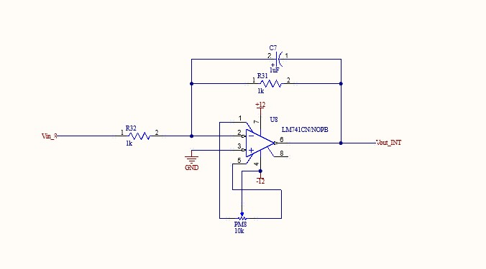
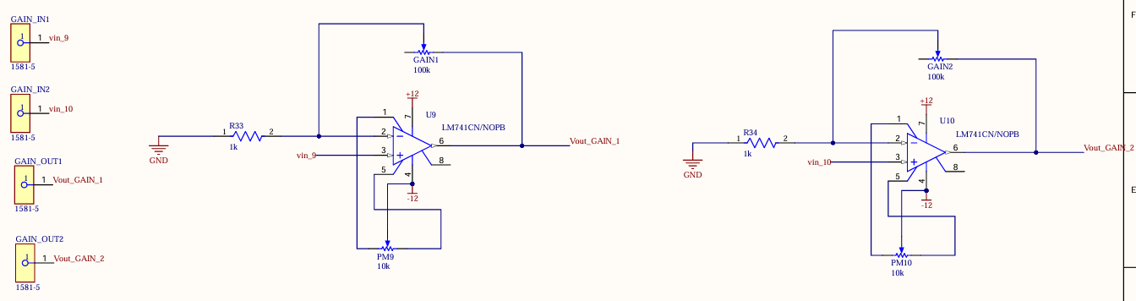
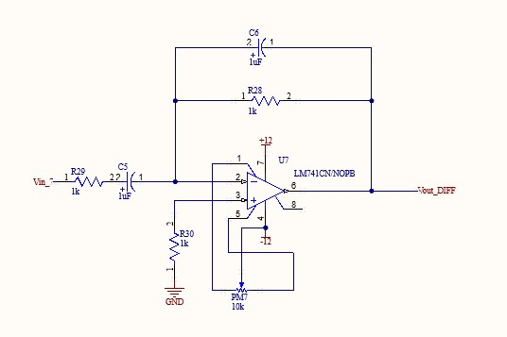
Schematic Diagrams.
Integrator Circuit
Gain Control Circuits
Differentiator Circuit

Slide 8
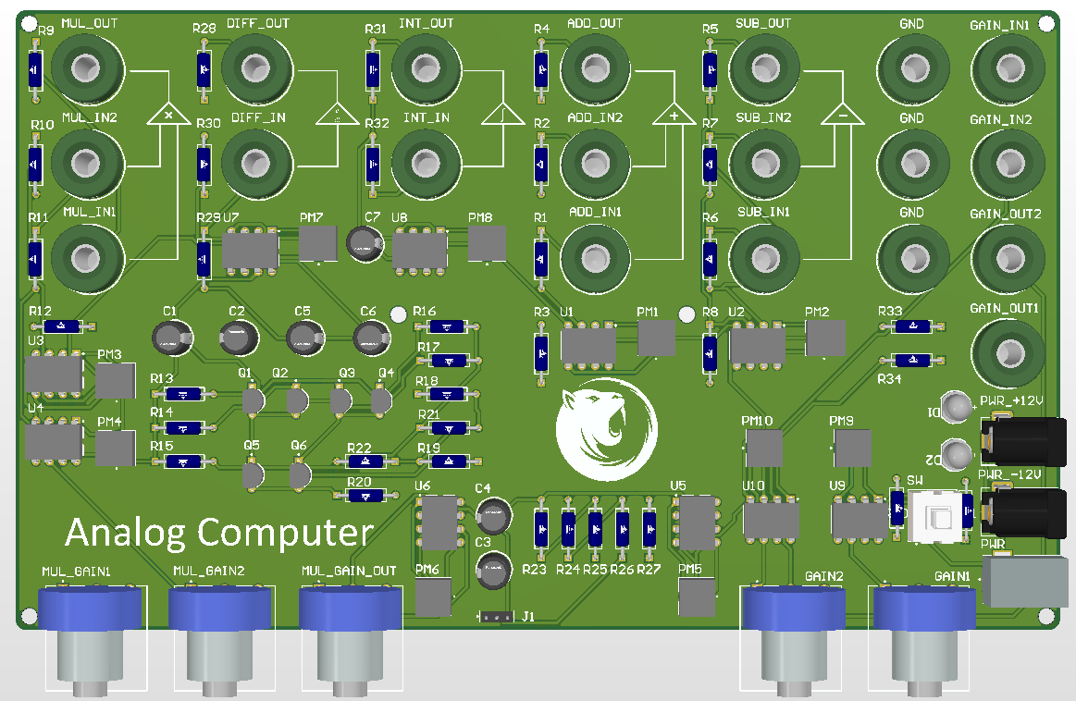
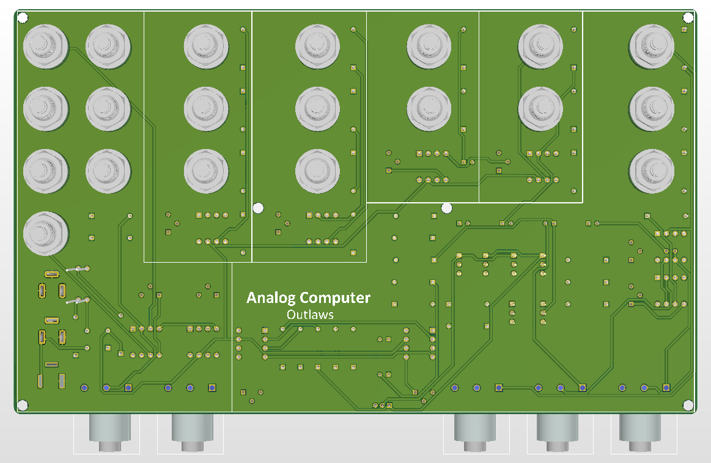
PCB Design.

Slide 9
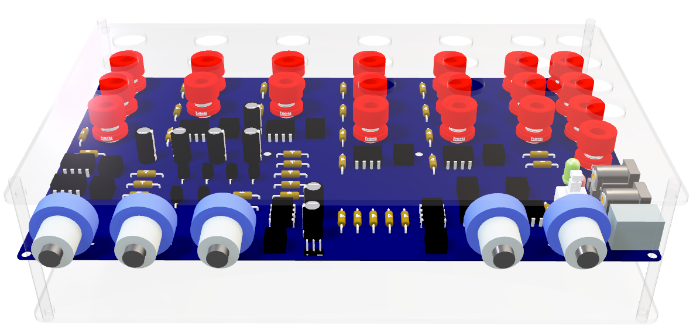
Analog Computing.
Precision in every operation.

Slide 10
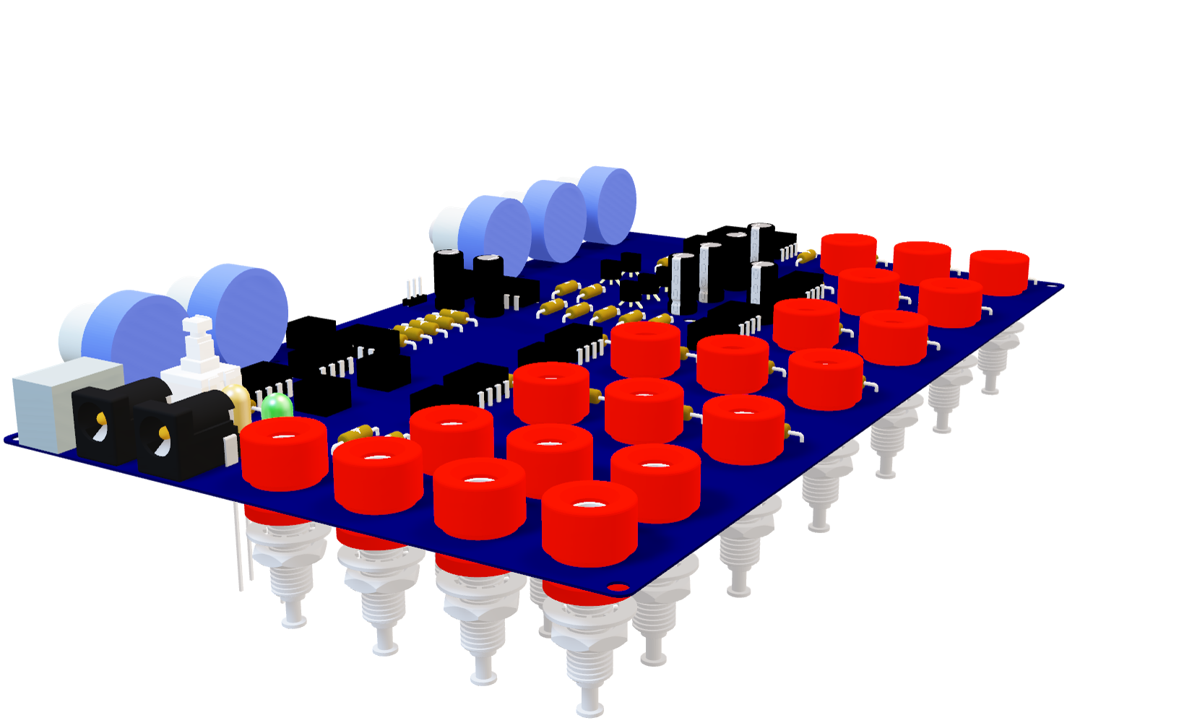






Parelle operation modes
Adjustable gain controls
Dual-channel input interfaces
Stable power supply design
Wide frequency range
High Accuracy and minimal distortion

Slide 11
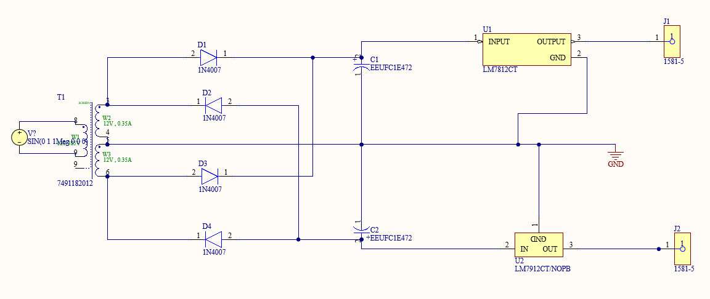
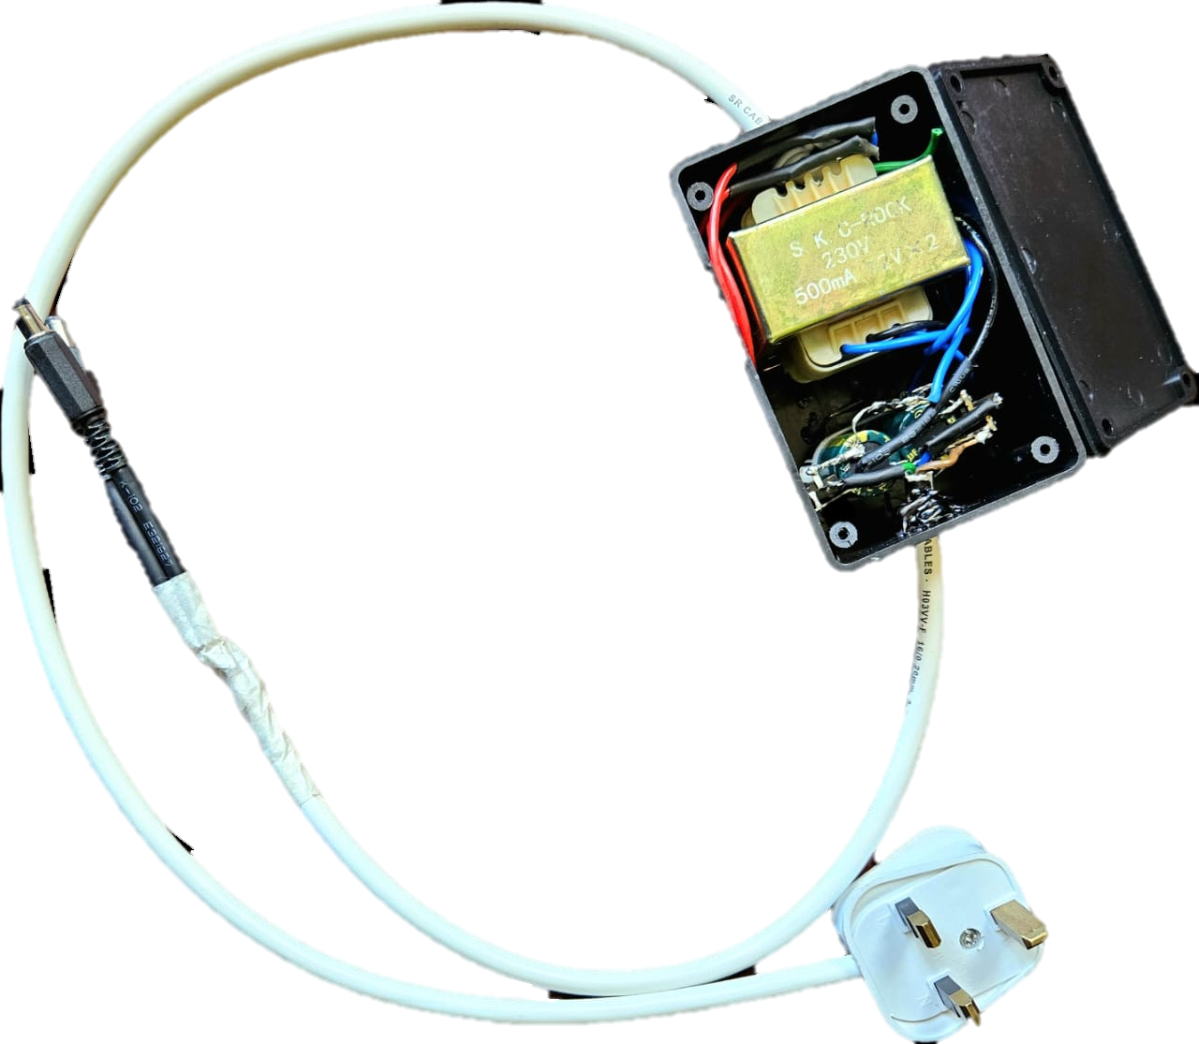
Power Supply.
Stable energy. Flawless results.
Converts 230V AC into regulated ±12V DC, ensuring stable and clean power for the op-amp circuits. This reliable dual-voltage output minimizes noise and interference, enabling precise analog computations.

Slide 12
Task Allocation
Index Number | Name | Task
220145U | Dodampegama P.D. | PCB designing, Simulation, Testing
220072R | Basnayake B.M.N.S | PCB designing, Components assembly of the main PCB, Testing
220268A | Jayasundara A.J.M.K.K.B. | Enclosure designing, Simulation, Testing
220721H | Wijesinghe R.D.P.H. | PCB designing, Components assembly of the power supply, Testing

